Slide 1
BSOG MONTHLY PG PROGRAM
CASE PRESENTATION
Dr. Shazia
Dr. Shreya
St. John’s Medical College Hospital, Bangalore.

Slide 2
HISTORY

Slide 3
DEMOGRAPHIC DETAILS
Mrs A
27 year old, educated upto 5th standard,
Homemaker from Ramnagara
Married to Mr. A, a bus conductor by occupation (educated upto 11th standard),
belonging to Lower Middle class socio-economic status (acc. to Modified Kuppuswamy Classification)
Notes:
4 (high school) + 5 (clerical) + 4 (per capita 500-749) = 13
11-15 (lower middle)

Slide 4
She is
Gravida 2, Para 1, Living 1, Abortion 0
LMP 28/5/23, EDD 4/3/24
36 weeks (examined on 5/2/24)
Booked at Ramnagara PHC (15 minutes away from her residence)

Slide 5
PRESENTING COMPLAINTS
c/o abdominal pain x 1 day

Slide 6
HISTORY OF PRESENTING COMPLAINTS
  She was apparently well until 1 day ago, when she developed abdominal pain
  Lower abdomen
  Intermittent, associated with tightening
  Radiating to back and thighs
  Gradually increasing in severity, duration and frequency

Slide 7
HISTORY OF PRESENTING COMPLAINTS
Appreciating foetal movements well
No leaking or bleeding per vagina
No h/o foul-smelling vaginal discharge
No h/o burning micturition or increased frequency of micturition
No h/o fever or chills
No h/o loose stools or vomiting

Slide 8
HISTORY OF PRESENTING COMPLAINTS
No h/o easy fatigability, breathlessness, palpitations, chest pain or swelling of lower limbs
No h/o haematemesis or melaena
No h/o yellowish discolouration of skin or eyes
No h/o bleeding gums, easy bruising
No h/o chronic cough, low grade fever with evening rise in temperature
No h/o acute persistent abdominal pain, bone pain, pluritic chest pain

Slide 9
HISTORY OF PRESENT PREGNANCY
1st trimester
Spontaneous conception
Pregnancy detected at 2 months of amenorrhoea with home UPT kit
Booking visit at Ramnagara PHC, dating scan done
Continued on Tab. Folic acid
(Patient had been on folic acid during inter-conceptional period also)
At 3 months gestation, Hb was 6.2g/dL
No h/o breathlessness, palpitations, leg swelling, easy fatigability
Notes:
Dating scan told to be normal

Slide 10
HISTORY OF PRESENT PREGNANCY
1st trimester (contd.)
Liver and Kidney function tests were done and told to be normal.
Transfused with 2 pints PRBC. Repeat Hb was 8g/dL.
Tab Folic acid 5mg OD continued and Tab. Aspirin 75mg OD added.
No h/o excessive vomiting, leaking or bleeding PV
No h/o fever with rash, exposure to teratogenic drugs or radiation
NT scan not done.

Slide 11
HISTORY OF PRESENT PREGNANCY
2nd trimester (2 visits)
Quickening at 5th month of gestation
Received 2 doses of Inj. Td at 4th and 5th months.
Started on oral iron and calcium tablets and continued of Tab. FA 5mg OD, patient was compliant
Screening for GDM was done and was said to be normal.

Slide 12
HISTORY OF PRESENT PREGNANCY
2nd trimester (contd.)
At 5th month patient visited the OBG Out-Patient Department at SJMCH, Hb- 6.3 g/dl
Was explained the need for further investigations and blood transfusion, but refused.
No h/o increased BP readings, breathlessness, chest pain, bone/joint pain, swelling of limbs, bleeding or leaking PV.
Notes:
Refused due to a family emergency

Slide 13
HISTORY OF PRESENT PREGNANCY
3rd trimester (3 visits)
At 29 weeks of gestation, she came to SJMCH and agreed for admission.
On evaluation,
  Complete blood count was done, showed:
  Hb 7.4g/dL
  RBC 3.18 million/mcL
  TLC 11,410/mcL
  DC N-57, L-33, E-1, M-8, B-0
  Platelet 3.72lakh/mcL

Slide 14
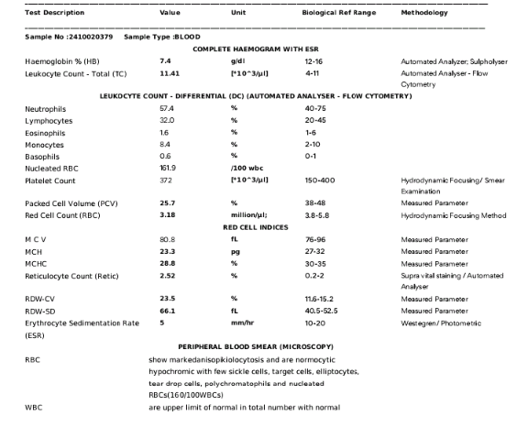
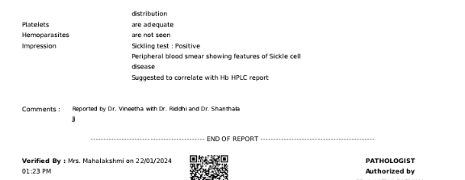

Slide 15
HISTORY OF PRESENT PREGNANCY
3rd trimester (3 visits)
Peripheral smear showed RBCs with marked anisopoikilocytosis, normocytic hypochromic RBCs, with few sickle cells, target cells, elliptocytes, teardrop cells, polychromatophils and nucleated RBCs
Reticulocyte count 2.52 (normal 0.2-2)
Nucleated RBCs 160/100WBCs
LFT and RFT done were within normal limits,
  With the exception of Total Bilirubin 3.23 and Direct Bilirubin 1.7
  LDH was 325 (elevated)
Notes:
Normal TB 0.2-1.2, DB 0-0.5

Slide 16
HISTORY OF PRESENT PREGNANCY
3rd trimester (3 visits)
Haemoglobin HPLC
  HbA : 18.9% (95-98%)
  HbA2 : 5.4% (2.2-3.5%)
  HbF : 7% (0-1%)
  HbS : 67.1%
  Suggested to repeat Hb HPLC after a 3 month transfusion-free interval
Transfused 1 unit PRBC.
Urine routine and microscopy done, Fundoscopy done, Growth scan done at 29 weeks were within normal limits. She was discharged and advised to follow up on OPD basis.

Slide 17
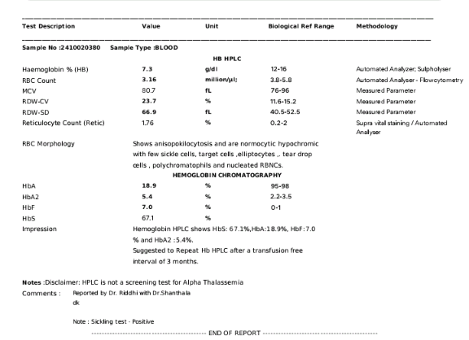

Slide 18
HISTORY OF PRESENT PREGNANCY
3rd trimester (3 visits)
Continued to perceive fetal movements well
No h/o bleeding PV, malaena, hematemesis.
Two interval growth scans done (29 weeks and 34 weeks) – All parameters within normal limits
Presented to SJMCH at 36 weeks with the above complaints

Slide 19
OBSTETRIC HISTORY
MARITAL HISTORY :
  Married life of 5 years.
  2nd degree consanguinity – husband is mother’s brother
1st Pregnancy (2021)
Had been booked at Ramnagara PHC.
Referred to a tertiary care hospital during the 3nd trimester, in view of persistently low Hb. On evaluation at this hospital, sickle cells were present on peripheral smear, Sickling test positive.
She had been treated as a case of sickle cell anaemia, though HPLC report not available.
Received 2 units PRBC transfusions antenatally
Notes:
Neonatal diagnosis of SCA – Metabolic screening – Tandem Mass Spectrometry
Recommended contraceptives -

Slide 20
OBSTETRIC HISTORY
1st Pregnancy (contd.)
Spontaneous onset preterm labour at 8 months of gestation.
Spontaneously progressed and underwent PTVD
Live girl baby of 1.9kg.
2 units PRBC transfused intrapartum i/v/o PPH.
Baby in NICU for 10 days i/v/o neonatal jaundice.
Evaluated for Sickle cell trait/disease, found to be negative.
Postnatally, patient continued on T. Folic acid 5mg OD
No contraceptive use
2nd pregnancy – present.
Notes:
Evaluated at 6 months of life

Slide 21
MENSTRUAL HISTORY
Attained menarche at 16 years of age
Regular menstrual cycles of 28-30 days
2-3 days of bleeding,
normal flow (2-3 moderately soaked pads/day)
LMP 28/05/2023
EDD 04/03/2024

Slide 22
PAST HISTORY
No history of T2DM, HTN, Thyroid abnormalities, seizure disorder, asthma, TB, chronic renal disease, liver disease, surgery.
No history of blood transfusion in childhood, recurrent jaundice or recurrent infections during childhood,
No h/o leg ulcers or gallstones
Unaware of sickle cell anaemia until diagnosis in first pregnancy

Slide 23
FAMILY HISTORY
Patient is born out of a non-consanguinous marriage.
No history of bleeding disorders in the family.
Husband tested for sickle cell trait and thalassemia trait and was found to be negative.
No history of T2DM, HTN, Thyroid abnormalities, seizure disorder, asthma, repeated blood transfusions, congenital anomalies, genetic disorders in the family.

Slide 24
PERSONAL HISTORY
Consumes a mixed diet
Appetite normal
Sleep adequate
Bowel and bladder habits normal and regular
No history of addictions
Consumes 2050kcal per day and 40gm protein per day according to 24 hour dietary recall
Deficit: 300kcal and 31g protein
Notes:
Required caloric intake 2000cal/day, protein 71g/day

Slide 25
SUMMARY
Ms A, a 27 year old G2P1L1 at 36 weeks of gestation,
a homemaker, belonging to Lower Middle SES, with features of preterm labour pains, is a known case of Sickle Cell Anemia, having received 3 units pRBC transfusion during the course of this pregnancy, compliant to daily Folic acid and Ecosprin, with no features of cardiac failure or sickle cell crisis symptoms currently.

Slide 26
CLINICAL EXAMINATION
Consent taken
Bladder voided
Privacy ensured
Adequately exposed

Slide 27
GENERAL PHYSICAL EXAMINATION
Conscious and co-operative
Well oriented to time, place and person
Moderately built and nourished
Height 151cm
Weight 55kg, (pre-pregnancy 46kg)
  weight gain = 9kg
BMI (pre-pregnancy) = 20.17kg/m

Slide 28
GENERAL PHYSICAL EXAMINATION
General condition – good
Pallor +++ (skin, palpebral conjunctivae, gums, oral mucosa, tongue)
Icterus +
No cyanosis, edema
No petechiae
Nails and hair – normal
No oral ulcers, gum bleeds
No leg ulcers
No bony tenderness
Breasts, Thyroid, Spine - normal

Slide 29
SYSTEMIC EXAMINATION
CVS examination
  Pulse rate 94bpm
    regularly regular rhythm, adequate volume, character of the vessel wall normal, no radio-radial or radio-femoral delay
    Measured in the Right radial artery
  - BP 100/64mm of Hg in Left brachial artery, in supine position
  - JVP not elevated
  - SpO2 98% (room air)
  - Apex beat palpated in L 5th ICS, 1cm lateral to MCL
  - S1 and S2 heard on auscultation, no murmurs

Slide 30
SYSTEMIC EXAMINATION
RS examination
- bilateral air entry equal
- normal vesicular breath sounds present
- no added sounds
CNS – no focal neurological deficits
P/A - No palpable hepato/splenomegaly

Slide 31
OBSTETRIC EXAMINATION
Inspection
- abdomen uniformly distended, ovoid
- umbilicus central and everted
- linea nigra and stria gravidarum seen
- no dilated veins, scars or sinuses seen
- hernial orifices normal
- foetal movements observed

Slide 32
OBSTETRIC EXAMINATION
Palpation
- Fundal height 34-36 weeks, flanks not full,
- liquor clinically adequate
- SFH 34cm, AG 90cm
- Estimated foetal weight = 3410g (Johnson’s formula)
- normal tone, 10”/2/10’

Slide 33
OBSTETRIC EXAMINATION
OBSTETRIC GRIPS
Fundal grip : a broad, soft, non-ballotable mass, s/o foetal breech
Umbilical grips
  Right – multiple irregular knob-like structures, s/o foetal limbs
  Left – uniform curved resistance, s/o foetal spine
1st pelvic grip : a hard, globular, ballotable mass, s/o mobile foetal head
2nd pelvic grip : hands converging, s/o foetal head not engaged
Auscultation : FHS present in Left spino-umbilical line, FHR 150bpm

Slide 34
OBSTETRIC EXAMINATION
P/S : vaginal mucosa pale
  Cervix healthy, Os appears open
  No abnormal discharge
P/V : Cervix 2.5cm long, soft, mid-position,
  Os 1FT, membranes present
  PP vertex high up
  Pelvis adequate
  Bishop’s score : 4

Slide 35
DIAGNOSIS
27 year old G2P1L1 at 36 weeks of gestation with longitudinal lie, in cephalic presentation in preterm labour in k/c/o Sickle cell anaemia, with severe anaemia not in failure, with no features of sickle cell crisis

Slide 36
INTRA-PARTUM MANAGEMENT
1ST STAGE OF LABOUR
Propped up position
O2 given
Adequate labour analgesia
Limit/minimise pelvic examinations
Vitals monitoring (esp. SpO2, pulse rate, chest auscultation)
Hydration – oral preferred
Prophylactic antibiotics
PRBC transfusion based on Hb%
Notes:
W/F cardiac failure

Slide 37
INTRA-PARTUM MANAGEMENT
2ND STAGE OF LABOUR
To be cut short
3RD STAGE OF LABOUR
- Active Management of third stage of labour
Notes:
W/F cardiac failure

Slide 38
POST-PARTUM MANAGEMENT
Monitoring of vitals
Antibiotics to be continued
Anaemia correction to be done
Contraceptive advice at discharge.

Slide 39
THANK YOU

